Slide 1
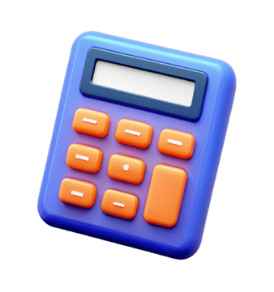
PYTHON PROJECT-1
GUI CALCULATOR

Slide 2
NIDHIRAJ PANDEY
ORGANISATION NAME :- NEXTHITES IT SOLUTION
INTERNSHIP PROJECT :- GUI CALCULATOR

Slide 3
INTRODUCTION
A GUI CALCULATOR PROJECT GIVEN BY THE NEXTHITES IT SOLUTION ORGANISATION
BY USING THE REFERENCES CODE I MADE A GUI CALCULATOR .
BY USING THE TKINTER LIBRARY IN PYTHON GUI CALCULATOR WAS CREATED .

Slide 4

PROBLEM FACE
THIS IS MY 1ST TIME WHEN I AM USING PYTHON AND CREATING SOMETHING THROUGH USING THE CODE.
THE MAIN ISSUE WHICH I FACED IS THAT , I MAKE THE BUTTON BUT UNABLE TO CONNECT OR LINKED IT WITH THE CODE
ALL THE CODE IS TOTALY NEW FOR ME BUT IT WAS A NICE WAY TO LEARN SOMETHING.

Slide 5
INPUT AND OUTPUT I GET
CODE
button1 = Button(gui, text=' 1 ', fg='black', bg='pink',
command=lambda: press(1), height=1, width=7)
button1.grid(row=4, column=0)
> I USE THIS CODE FPR CREATING A BUTTON IN THE CALCULATOR
OUTPUT
> KEY IN THE CALCULATOR IS CREATED BY THIS

Slide 6

HOW I DEFINE THE KEY
def press(num):
global expression
expression = expression + str(num)
equation.set(expression)
I USE THIS CODE FOR DEFINING THE KEY
OUTPUT
>THIS CODE HELP IN DEFINING THE FUNCTION OF THE BUTTON

Slide 7
WHAT I LEARN
USES OF PYTHON LANGUAGE
LEARN TO CODE A GUI CALCULATOR BY USING TKINTER LIBRARY
LEARN HOW TO INTERPRET THE CODE IN PYTHON.
HOW TO DEAL WITH THE CODE WHEN THERE IS AN ERROR

Slide 8
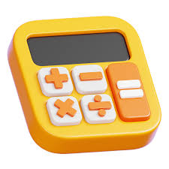
CONCLUSION
This project help me in learning the python coding
By the help of this project I learn how to interpret the code .
The challenges which I face while working in the project will make me able to deal or handel the problem faces d uring the work.
This project help me to increasing my knowledge and level of patience.

